Slide 1
Part 3: Transport Layer

Slide 2
Part 3: Transport Layer
Chapter goals:
Understand principles behind transport layer services:
Multiplexing/demultiplexing
Reliable data transfer
Flow control
Congestion control
Instantiation and implementation in the Internet
Chapter Overview:
Connection-oriented transport: TCP
Reliable transfer
Flow control
Connection management
Principles of congestion control
TCP congestion control

Slide 3



TCP: Overview RFCs: 793, 1122, 1323, 2018, 2581
Point-to-point:
One sender, one receiver
In-order byte steam:
No “message boundaries”
Pipelined:
TCP congestion and flow control set window size
Send & receive buffers
Reliable
Full duplex data:
Bi-directional data flow in same connection
MSS: Maximum segment size
Connection-oriented:
Handshaking (exchange of control msgs) inits sender, receiver state before data exchange
Flow controlled:
Sender will not overwhelm receiver
Congestion control: To avoid network router buffer overflow

Slide 4
TCP
Transmission Control Protocol
Key Services:
Send: Please send when convenient
Data stream push: Destination TCP, please deliver it immediately to the receiving application.
⇒ Source TCP, please send it now.
Set on last packet of an application message.
Urgent data signaling: Destination TCP, please give this urgent data to the user out-of-band. Generally used for CTRL-C.

Slide 5
TCP Segment Structure
32 bits
URG: urgent data
(generally not used)
Counting by bytes of data
(not segments!)
Source port #
Dest port #
Sequence number
ACK: ACK # valid
Acknowledgement number
Head
Len
Not
Used
U
Rcvr window size
A
PSH: push data now
(Generally not used)
P
R
S
F
# Bytes
receiver willing
to accept
Checksum
Ptr urgent data
RST, SYN, FIN:
Connection establishment
(Setup, teardown cmds)
Options (variable length)
Pad
N.B: Every byte is numbered
Seq, ack are byte number
Application
data
(variable length)
Internet
Checksum
(As in UDP)

Slide 6
TCP Header Fields
Source Port (16 bits): Identifies source user process
Destination Port (16 bits) 21 = FTP, 23 = Telnet, 53 = DNS, 80 = HTTP, ...
Sequence Number (32 bits): Sequence number of the first byte in the segment. If SYN is present, this is the initial sequence number (ISN) and the first data byte is ISN+1.
Ack number (32 bits): Next byte expected (got previous and expecting next)
Data offset (4 bits): Number of 32-bit words in the header
Reserved (6 bits)

Slide 7

TCP Header Fields (Cont.)
Control (6 bits): Urgent pointer field significant,
Ack field significant,
Push function,
Reset the connection,
Synchronize the sequence numbers,
No more data from sender
Window (16 bits): Will accept [Ack] to [Ack]+[window]-1
N. B.Byte number not packet or other
ACK is always 1 step ahead

Slide 8
TCP Header Fields (Cont.)
Checksum (16 bits): covers the segment plus a pseudo header. Includes the following fields from IP header: source and dest adr, protocol, segment length. Protects from IP misdelivery. (initially TCP and IP were one protocol) (layering violation here)
Urgent pointer (16 bits): Points to the byte following urgent data. Lets receiver know how much data it should deliver right away out-of-band. (out of order)
Options (variable): Max segment size (does not include TCP header, default 536 bytes), Window scale factor, Selective Ack permitted, Timestamp, No-Op, End-of-options

Slide 9
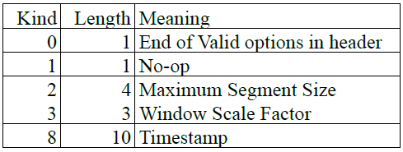
TCP Header Fields (Cont.)
1b
1b
T-L-V format
End of Options: Stop looking for further option
No-op: Ignore this byte. Used to align the next option on a 4-byte word boundary
Max Segment Size (MSS): Does not include TCP header

Slide 10


TCP Header Fields (Cont.)
Checksum is the 16-bit one's complement of the one's complement sum of a pseudo header of information from the IP header, the TCP header, and the data, padded with zero octets at the end (if necessary) to make a multiple of two octets.
Checksum field is filled with zeros initially
TCP length (in octet) is not transmitted but used in calculations.
Efficient implementation in RFC1071.

Slide 11
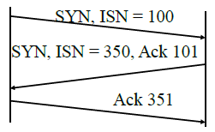
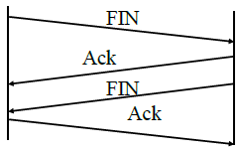
TCP Header Fields (Cont.)
Connection Establishment
Three way handshake
SYN flag set ⇒ Request for connection
Connection Termination q
Close with FIN flag set
Abort
ISN=Initial Sequence Number

Slide 12
TCP Sequence #s and ACKs
Seq. #’s:
Byte stream “number” of first byte in segment’s data
ACKs:
Seq. # of next byte expected from other side
Cumulative ACK
Q: How does receiver handle out-of-order segments?
A: TCP spec doesn’t say, up to implementer
Host A
Host B
User
types
‘C’
Seq=42, ACK=79, data = ‘C’
Host ACKs
receipt of
‘C’, echoes
back ‘C’
Seq=79, ACK=43, data = ‘C’
Host ACKs
receipt
of echoed
‘C’
Seq=43, ACK=80
time
Simple Telnet Scenario

Slide 13
TCP ACK Generation [RFC 1122, RFC 2581]
Event
In-order segment arrival,
no gaps,
everything else already ACKed
In-order segment arrival,
no gaps,
one delayed ACK pending
Out-of-order segment arrival
higher-than-expect seq. #
gap detected
Arrival of segment that
partially or completely fills gap
TCP Receiver Action
Delayed ACK. Wait up to 500ms
for next segment. If no next segment,
send ACK
Immediately send single
cumulative ACK
Send duplicate ACK, indicating seq. #
of next expected byte
Immediate ACK if segment starts
at lower end of gap

Slide 14
TCP: Retransmission Scenarios
Host A
Host B
Host A
Host B
Seq=92, 8 bytes data
Seq=92, 8 bytes data
Seq=100, 20 bytes data
timeout
ACK=100
Seq=92 timeout
X
ACK=100
Seq=100 timeout
ACK=120
loss
Seq=92, 8 bytes data
Seq=92, 8 bytes data
ACK=120
ACK=100
time
time
Premature timeout,
cumulative ACKs
Lost ACK scenario

Slide 15
RTT
buffers
The network must have buffers (to enable statistical multiplexing)
The buffer occupancy is time-varying
As flows start and stop, congestion grows and decreases, causing buffer occupancy to increase and decrease.
RTT is time-varying. There is no single RTT.
Solution: make RTO a function of a smoothed RTT

Slide 16
Smooth RTT
EstimatedRTT = (1- α)*EstimatedRTT + α*SampleRTT
Exponential weighted moving average
influence of past sample decreases exponentially fast
typical value: α = 0.125

Slide 17
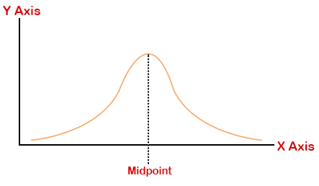
TCP Round Trip Time and Timeout
Setting the timeout (RTO)
RTO = EstimtedRTT plus “safety margin”
large variation in EstimatedRTT -> larger safety margin
first estimate of how much SampleRTT deviates from EstimatedRTT:
DevRTT = (1-β)*DevRTT +
β*|SampleRTT-EstimatedRTT|
(typically, β = 0.25)
Then set timeout interval:
RTO = EstimatedRTT + 4*DevRTT

Slide 18
TCP Round Trip Time and Timeout
RTO = EstimatedRTT + 4*DevRTT
Might not always work
RTO = max(MinRTO, EstimatedRTT + 4*DevRTT)
MinRTO = 250 ms for Linux
500 ms for windows
1 sec for BSD
So in most cases RTO = minRTO
Actually, when RTO>MinRTO, the performance is quite bad; there are many spurious timeouts.
Note that RTO was computed in an ad hoc way. It is really a signal processing and queuing theory question…

Slide 19
TCP Round Trip Time and Timeout
Exponential weighted moving average
Influence of given sample decreases exponentially fast
Typical value of x: 0.1
Setting the timeout
EstimatedRTT plus “safety margin”
Large variation in EstimatedRTT needs larger safety margin

Slide 20
Principles of Congestion Control
Congestion:
Informally: “too many sources sending too much data too fast for network to handle”
Different from flow control!
Manifestations:
Lost packets (buffer overflow at routers)
Long delays (queueing in router buffers)
Top-10 problem!

Slide 21
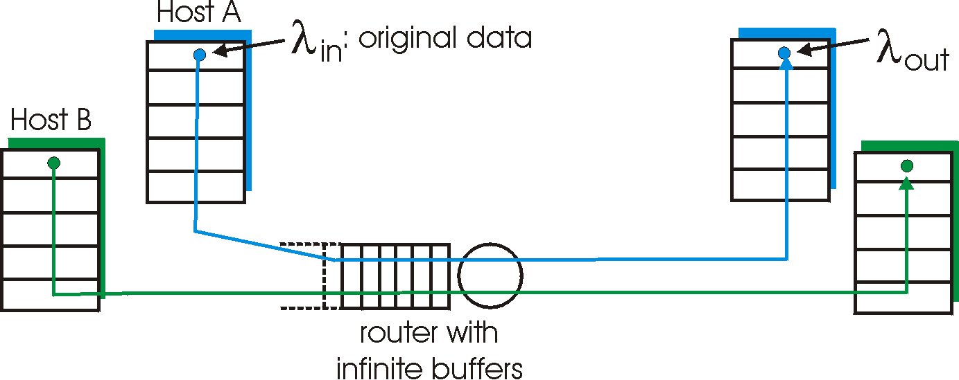
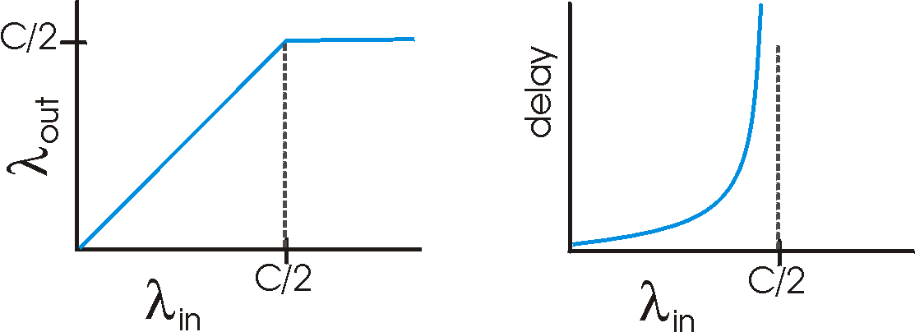
Causes/Costs of Congestion: Scenario 1
Two senders, two receivers
One router, infinite buffers
No retransmission
Large delays when congested
Maximum achievable throughput

Slide 22
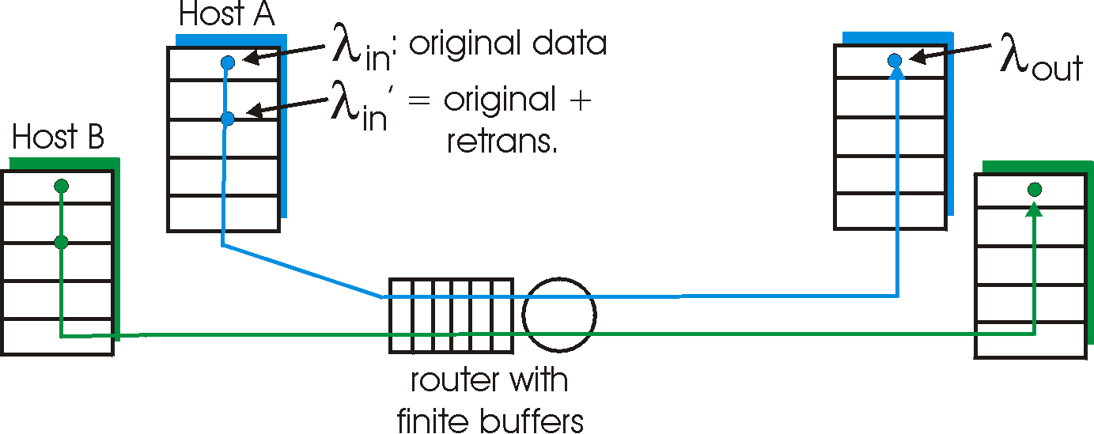
Causes/Costs of Congestion: Scenario 2
One router, finite buffers
Sender retransmission of lost packet

Slide 23
Approaches Towards Congestion Control
Two broad approaches towards congestion control:
End-end congestion control:
No explicit feedback from network
Congestion inferred from end-system observed loss, delay
Approach taken by TCP
Network-assisted congestion control:
Routers provide feedback to end systems
Single bit indicating congestion (SNA, DECbit, TCP/IP ECN, ATM)
Explicit rate sender should send at

Slide 24
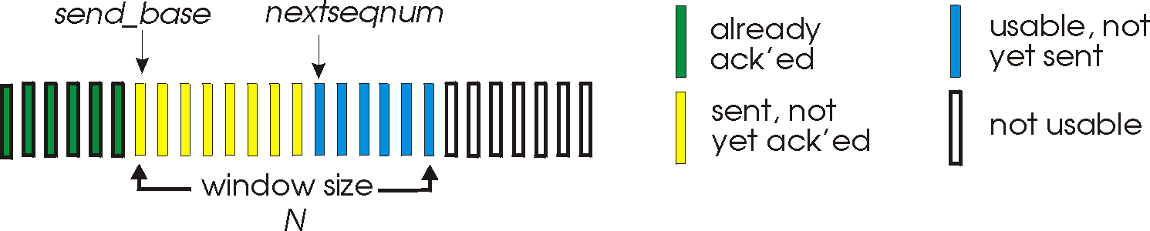
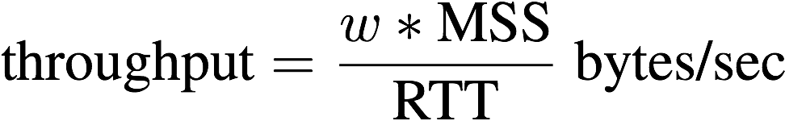
TCP Congestion Control (1)
End-end control (no network assistance)
Transmission rate limited by congestion window size, cwnd, over segments:
cwnd
w segments, each with MSS bytes sent in one RTT:

Slide 25
TCP Congestion Control (2)
“Probing” for usable bandwidth:
Ideally: transmit as fast as possible (cwnd as large as possible) without loss
Increase cwnd until loss (congestion)
Loss: decrease cwnd, then begin probing (increasing) again
Two “phases”
Slow start
Congestion avoidance
Important variables:
cwnd
ssthresh: defines threshold between two slow start phase, congestion control phase

Slide 26
Approaches towards congestion control
two broad approaches towards congestion control:
end-end congestion control:
no explicit feedback from network
congestion inferred from end-system observed loss, delay
approach taken by TCP
network-assisted congestion control:
routers provide feedback to end systems
single bit indicating congestion (SNA, DECbit, TCP/IP ECN, ATM)
explicit rate for sender to send at

Slide 27
Case study: ATM ABR congestion control
ABR: available bit rate:
“elastic service”
if sender’s path “underloaded”:
sender should use available bandwidth
if sender’s path congested:
sender throttled to minimum guaranteed rate
RM (resource management) cells:
sent by sender, interspersed with data cells
bits in RM cell set by switches (“network-assisted”)
NI bit: no increase in rate (mild congestion)
CI bit: congestion indication
RM cells returned to sender by receiver, with bits intact

Slide 28

Case study: ATM ABR congestion control
RM cell
data cell
two-byte ER (explicit rate) field in RM cell
congested switch may lower ER value in cell
senders’ send rate thus max supportable rate on path
EFCI bit in data cells: set to 1 in congested switch
if data cell preceding RM cell has EFCI set, receiver sets CI bit in returned RM cell

Slide 29
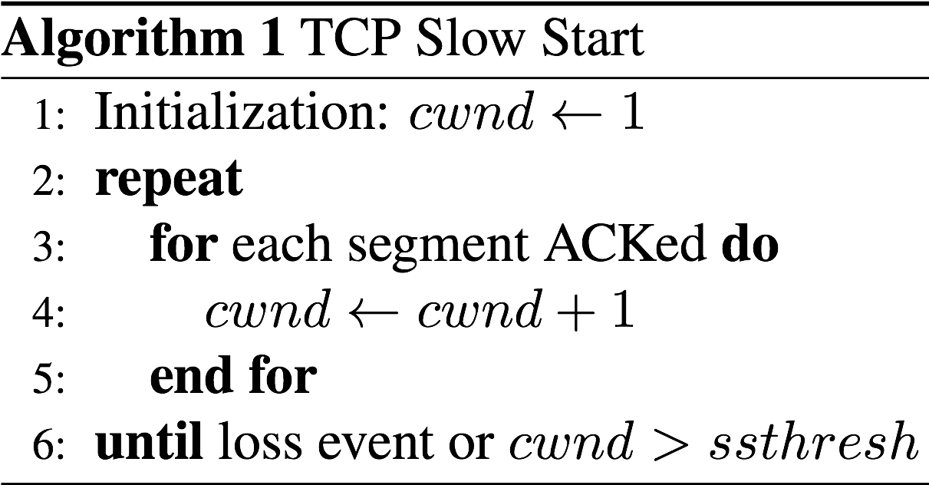
TCP Slow Start
Host A
Host B
one segment
RTT
two segments
four segments
Exponential increase (per RTT) in window size (not so slow!)
Loss event: timeout (Tahoe TCP) and/or or three duplicate ACKs (Reno TCP)
time
Notes:
\begin{algorithm}
\caption{TCP Slow Start}
\begin{algorithmic}[1]
\STATE{Initialization: $cwnd \leftarrow 1$}
\REPEAT
\FOR{each segment ACKed}
\STATE{$cwnd \leftarrow cwnd + 1$}
\ENDFOR
\UNTIL{loss event or $cwnd > threshold$}
\end{algorithmic}
\end{algorithm}

Slide 30
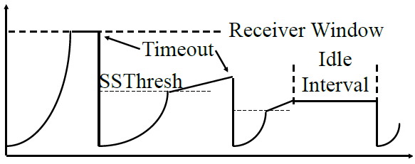
Slow Start Congestion Control
Initially SSThresh=Receiver window size
If segments lost, remember slow start threshold. SSThresh= CWND/2
Set CWND =1 MSS
Increment by 1MSS per ack until SSThresh
Increment by 1 MSS*MSS/CWND per ack afterwards
bytes
Congestion Window CWND
1MSS
Notes:
\begin{algorithm}
\caption{TCP Slow Start}
\begin{algorithmic}[1]
\STATE{Initialization: $cwnd \leftarrow 1$}
\REPEAT
\FOR{each segment ACKed}
\STATE{$cwnd \leftarrow cwnd + 1$}
\ENDFOR
\UNTIL{loss event or $cwnd > threshold$}
\end{algorithmic}
\end{algorithm}

Slide 31
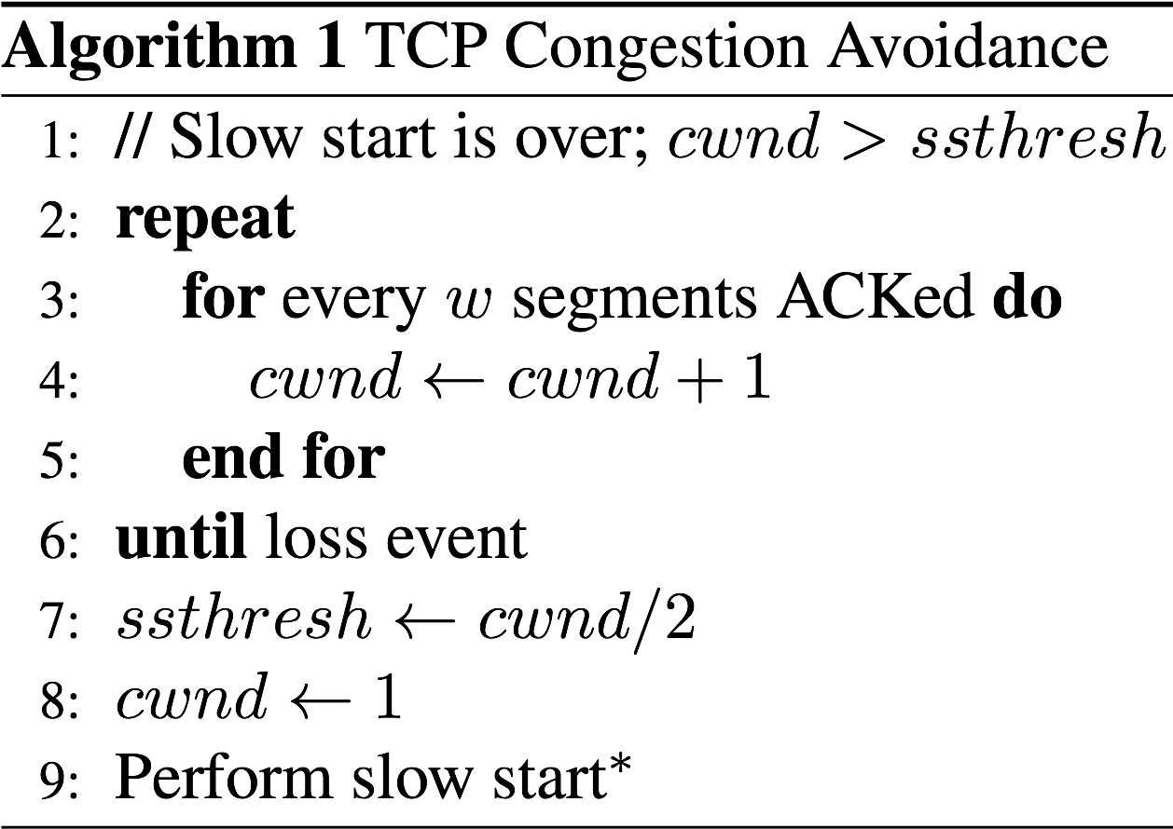
TCP Congestion Avoidance
* TCP Reno skips slow start (fast
recovery) after three duplicate ACKs
Notes:
\begin{algorithm}
\caption{TCP Congestion Avoidance}
\begin{algorithmic}[1]
\STATE{// Slow start is over; $cwnd > threshold$}
\REPEAT
\FOR{every $w$ segments ACKed}
\STATE{$cwnd \leftarrow cwnd + 1$}
\ENDFOR
\UNTIL{loss event}
\STATE{$threshold \leftarrow cwnd/2$}
\STATE{$cwnd \leftarrow 1$}
\STATE{Perform slow start$^{*}$}
\end{algorithmic}
\end{algorithm}

Slide 32
Fast Retransmit and First Recovery
Optional – implemented in TCP Reno
(Earlier version was TCP Tahoe)
Duplicate Ack indicates a lost/out-of-order segment
On receiving 3 duplicate acks (4th ack for the same segment):
Enter Fast Recovery mode
Retransmit missing segment
Set SSThresh=CWND/2
Set CWND=SSThresh+MSS (some CWND=SSThresh+3 MSS)
Every subsequent duplicate ack: CWND=CWND+1MSS
When a new ack (not a duplicate ack) is received
Exit fast recovery
Set CWND=SSTHRESH

Slide 33
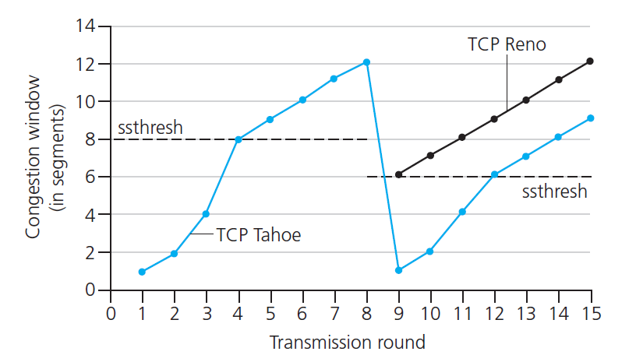
Time out
3 dup ack

Slide 34
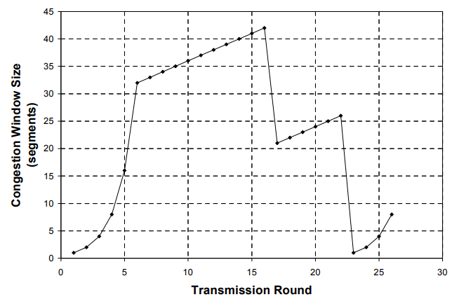
TCP Reno
3 dup ack
Fast Recovery
Fast Retransmit
Time out
Slow start

Slide 35
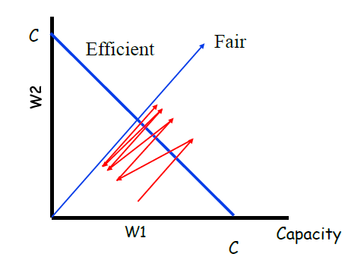
AIMD principal
Additive Increase, Multiplicative Decrease
Lets two users, using same link with capacity, C
W1 is the window of user 1, w2 is the window of user 2, and
W1+W2 = Capacity ⇒ Efficiency, W1=W2 ⇒ Fairness
(W1,W2) to (W1+ΔW,W2+ΔW) ⇒ Linear increase (45° line)
(W1,W2) to (kW1,kW2) ⇒ Multiplicative decrease (line through origin)
Fairness: everyone gets fair share
Efficiency; network resources are
used well
Notes:
\begin{algorithm}
\caption{TCP Congestion Avoidance}
\begin{algorithmic}[1]
\STATE{// Slow start is over; $cwnd > threshold$}
\REPEAT
\FOR{every $w$ segments ACKed}
\STATE{$cwnd \leftarrow cwnd + 1$}
\ENDFOR
\UNTIL{loss event}
\STATE{$threshold \leftarrow cwnd/2$}
\STATE{$cwnd \leftarrow 1$}
\STATE{Perform slow start$^{*}$}
\end{algorithmic}
\end{algorithm}

Slide 38
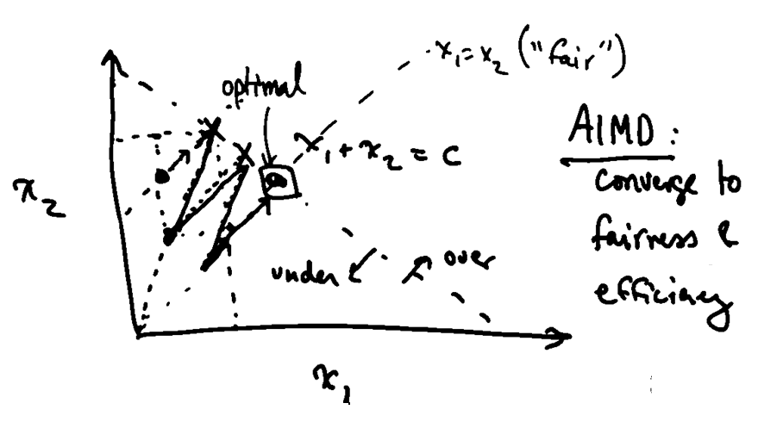

Slide 39
TCP Fairness
AIMD
TCP congestion avoidance:
AIMD: Additive increase, multiplicative decrease
Increase window by 1 per RTT
Decrease window by factor of 2 on loss event
Fairness goal: if N TCP sessions share same bottleneck link, each should get 1/N of link capacity
TCP connection 1
TCP
connection 2
Bottleneck
router
capacity C

Slide 40
Why is TCP Fair?
Two competing sessions:
Additive increase gives slope of 1, as throughout increases
Multiplicative decrease decreases throughput proportionally
R
Equal bandwidth share
Loss: decrease window by factor of 2
Congestion avoidance: additive increase
Connection 2 throughput
Loss: decrease window by factor of 2
Congestion avoidance: additive increase
Connection 1 throughput
R

Slide 41


Summary: TCP Congestion Control
New
ACK!
New
ACK!
.
duplicate ACK
new ACK
dupACKcount++
new ACK
cwnd = cwnd + MSS (MSS/cwnd)
dupACKcount = 0
transmit new segment(s), as allowed
cwnd = cwnd+MSS
dupACKcount = 0
transmit new segment(s), as allowed
Λ
cwnd = 1 MSS
ssthresh = 64 KB
dupACKcount = 0
cwnd > ssthresh
slow
start
Λ
congestion
avoidance
timeout
ssthresh = cwnd/2
cwnd = 1 MSS
dupACKcount = 0
retransmit missing segment
duplicate ACK
timeout
dupACKcount++
ssthresh = cwnd/2
cwnd = 1 MSS
dupACKcount = 0
retransmit missing segment
timeout
New
ACK!
ssthresh = cwnd/2
cwnd = 1
dupACKcount = 0
retransmit missing segment
New ACK
dupACKcount == 3
cwnd = ssthresh
dupACKcount = 0
dupACKcount == 3
ssthresh= cwnd/2
cwnd = ssthresh + 3
retransmit missing segment
ssthresh= cwnd/2
cwnd = ssthresh + 3
retransmit missing segment
fast
recovery
duplicate ACK
cwnd = cwnd + MSS
transmit new segment(s), as allowed

Slide 42
TCP throughput
avg. TCP thruput as function of window size, RTT?
ignore slow start, assume always data to send
W: window size (measured in bytes) where loss occurs
avg. window size (# in-flight bytes) is ¾ W
avg. thruput is 3/4W per RTT
avg TCP thruput =
3
W
4
RTT
bytes/sec
W
W/2

Slide 43
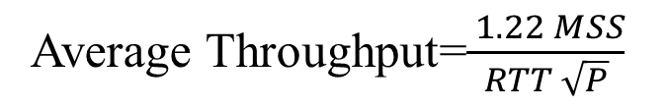
TCP Average Throughput
Average Throughput=$\frac{ 1.22 MSS}{RTT \sqrt{P}}$
Here, P = Probability of Packet loss

Slide 44
Explicit Congestion Notification (ECN)
Explicit congestion notification (ECN) is based on DECbit.
Two bits in IP Header:
00: Transport is not capable of ECN (e.g., UDP)
01: Transport is capable of ECN
10: Transport is capable of ECN
11: Congestion experienced (CE)
When a router encounters congestion, instead of dropping the
datagram, it marks the two bits as “11” congestion experienced

Slide 45
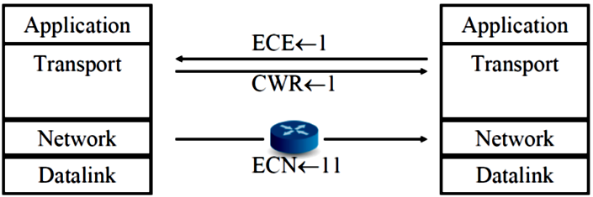
ECN (Cont)
On receiving “CE” code point, the receiver sends “ECN Echo (ECE)” flag in the TCP header
On seeing the ECE flag, the source reduces its congestion window, and sets “Congestion Window Reduced (CWR) flag in outgoing segment
On receiving “CWR” flag, the receiver, stops setting ECE bit

Slide 46
TCP Futures: TCP over “long, fat pipes”
example: 1500 byte segments, 100ms RTT, want 10 Gbps throughput
requires W = 83,333 in-flight segments
throughput in terms of segment loss probability, L [Mathis 1997]:
➜ to achieve 10 Gbps throughput, need a loss rate of L = 2·10⁻¹⁰ – a very small loss rate!
new versions of TCP for high-speed
1.22
.
MSS
TCP throughput =
RTT
L

Slide 47
Summary
Principles behind transport layer services:
Multiplexing/demultiplexing
Reliable data transfer
Flow control
Congestion control
Instantiation and implementation in the Internet
UDP
TCP
Next:
Leaving the network “edge” (application transport layer)
Entering the network “core”

Slide 48
Extra Slide

Slide 49
Slow Start Congestion Control
At the beginning, SSThresh = Receiver window
After a long idle period (exceeding one round-trip time), reset the congestion window to one.
If CWND is W MSS, W acks are received in one round trip.
Below SSThresh, CWND is increased by 1MSS on every ack ⇒ CWND increases to 2W MSS in one round trip ⇒ CWND increases exponentially with time. Exponential growth phase is also known as “Slow start” phase
Above SSThresh, CWND is increased by MSS/CWND on every ack ⇒ CWND increases by 1 MSS in one round trip ⇒ CWND increases linearly with time The linear growth phase is known as “congestion avoidance” phase
Notes:
\begin{algorithm}
\caption{TCP Slow Start}
\begin{algorithmic}[1]
\STATE{Initialization: $cwnd \leftarrow 1$}
\REPEAT
\FOR{each segment ACKed}
\STATE{$cwnd \leftarrow cwnd + 1$}
\ENDFOR
\UNTIL{loss event or $cwnd > threshold$}
\end{algorithmic}
\end{algorithm}

